Slide 1
Assessing the Credit Rating of SMEs and
Big Data Analysis
Naoyuki Yoshino
Dean, Asian Development Bank Institute (ADBI)
Professor Emeritus, Keio University, Japan
Farhad Taghizadeh-Hesary
Assistant Professor, Keio University, Japan
Visiting Professor, University of Tokyo

Slide 2
Analysis of SMEs in Asia
1, Importance of SMEs in Asia
2, Credit Guarantee to SMEs
3, Collection of SME data
4, Optimal credit guarantee ratio
5, Credit Analysis of SME
by use of big data

Slide 4
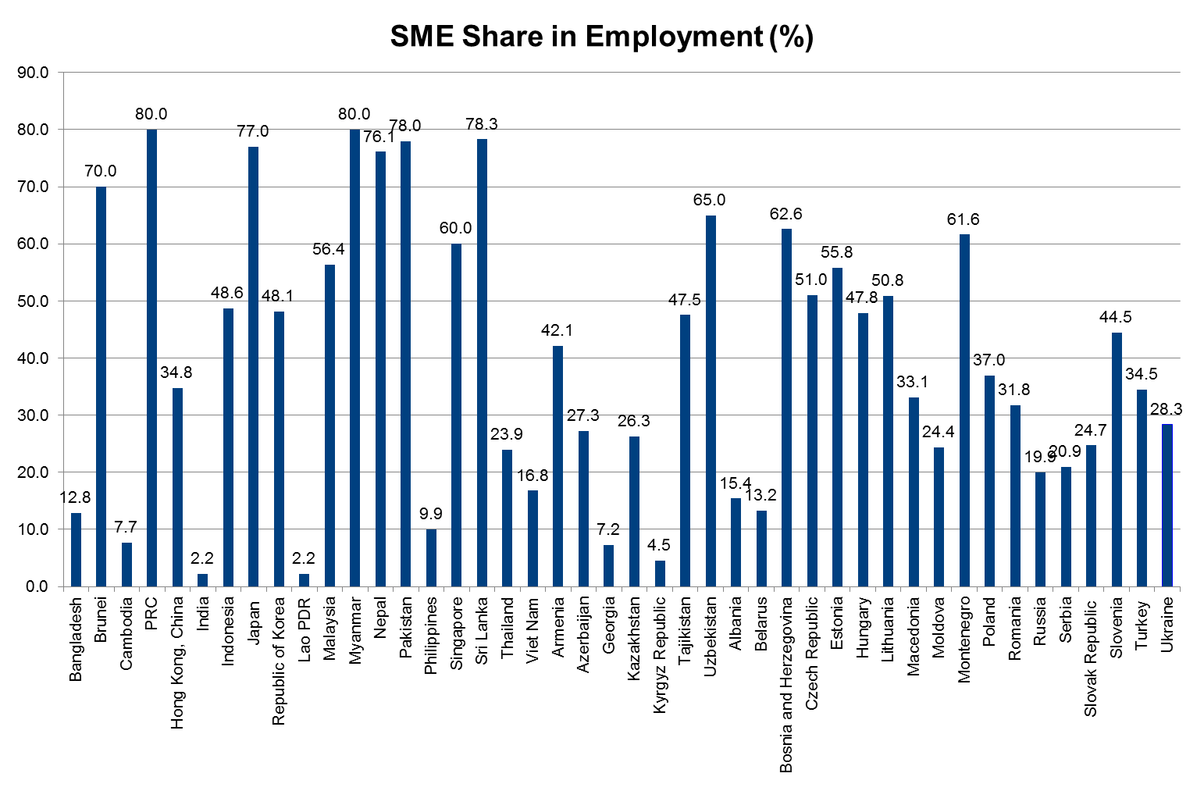
SMEs Share in Employment (%)

Slide 5
Borrower, Lender and Market
Borrower
SMEs
Individuals
Lender
Banks
MicroCredit
Market
Information Asymmetry
Especially SME market

Slide 6
Access to Finance by SMEs and Large Firms in Japan

Slide 7
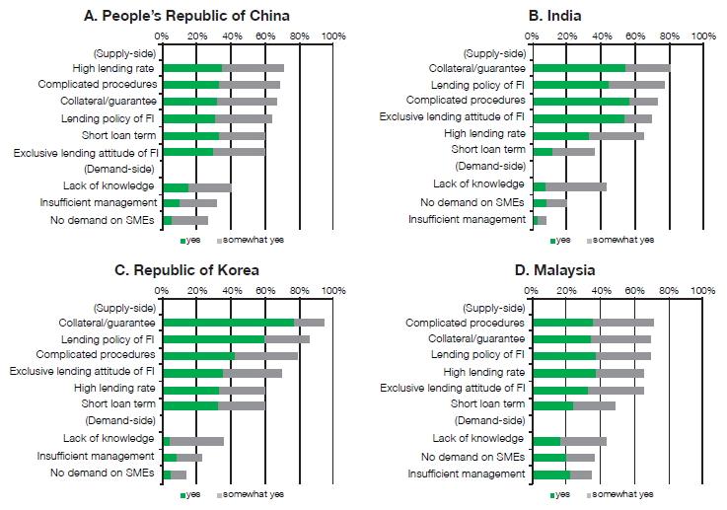
Barriers for SMEs in Accessing Financial Institutions, Collateral,Higher rate
Source: ADB–OECD study on enhancing financial accessibility for SMEs: Lessons from recent crises. Mandaluyong City, Philippines: Asian Development Bank, 2013

Slide 9
Small and Medium Sized Enterprise
(SME)
Venture business
Toyota,Honda,SevenEleven,Nintendo
Nintendo could not borrow from Mitsubishi.
HONDA was not supported by government.
Mr. HONDA worked at SME as a repairman.
HONDA could not borrow money
Mitsubishi-bank made loans to HONDA.
How to finance start-up business ?

Slide 16
Optimal Credit Guarantee Ratio

Slide 17
Cluster Analysis of SMES

Slide 18
Calculated Optimal Credit Guarantee ratios
the optimal credit guarantee ratio in our model depends on three groups of factors:
macroeconomic variables
government policies,
banking profile.
These two groups consist of various variables including:price of land, price of stock, gross domestic product (GDP), money supply, actual SME loans, fixed demand for loans, deposit interest rate, expected GDP, marginal increase of nonperforming loans by increase of additional loans, desired SME loans, desired default risk ratio of loan, weight for stabilizing the SME loans, weight for reducing the nonperforming loan ratio, and financial profile of banks.
Group 1 of banks: 0.775
Group 2 of banks: 0.683

Slide 29


Possible Solutions
Start up businesses, farmers
Hometown Investment
Trust Funds : Springer
--------------------------------------------------
A Stable Way to Supply Risk Capital
Yoshino, Naoyuki; Kaji Sahoko (Eds.)
2013,
Japan, Cambodia
Vietnam, Peru, Mongolia
Access to Digital Technology

Slide 30
Internet On-line trade
Start ups
Farmers
Innovators
Consumers
Internet
Company
Advertize
FSA： registration

Slide 31




Slide 32



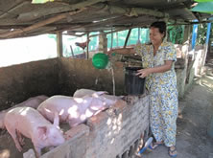
Investment in SMEs and start up businesses

